Slide 1

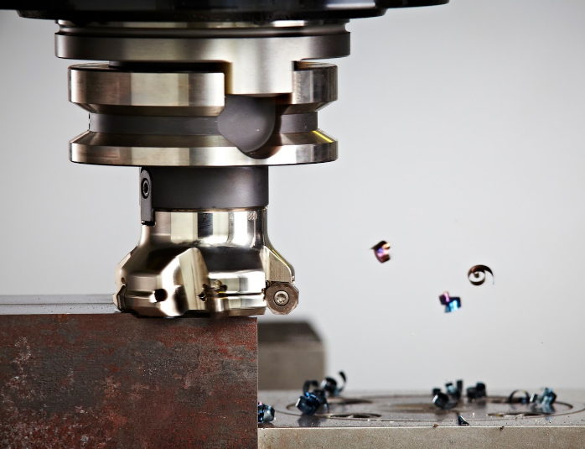
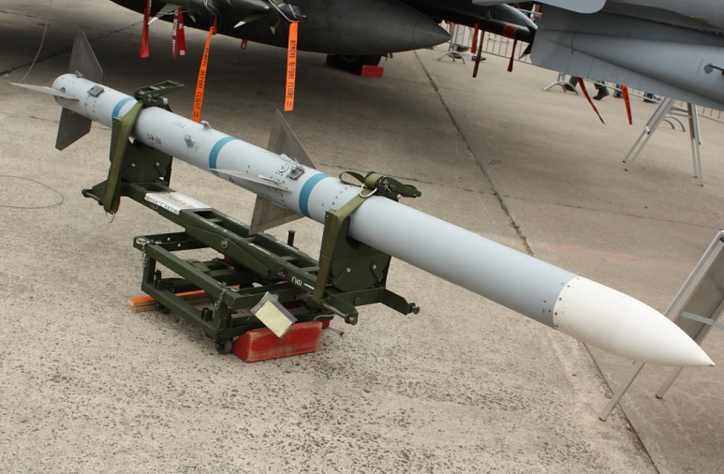
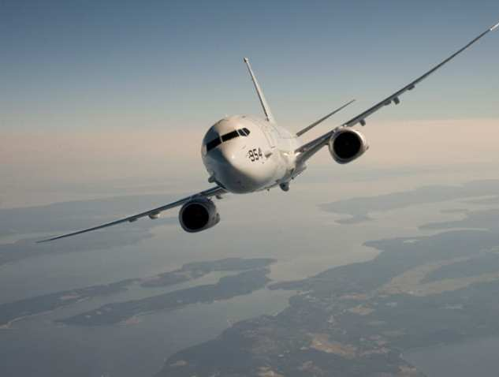
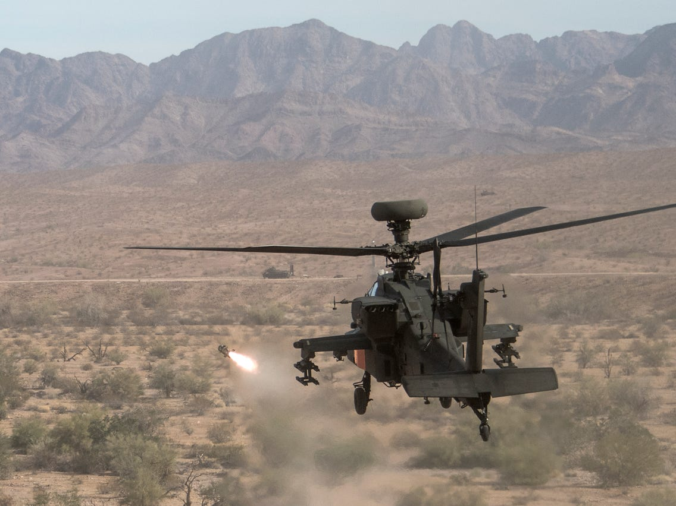
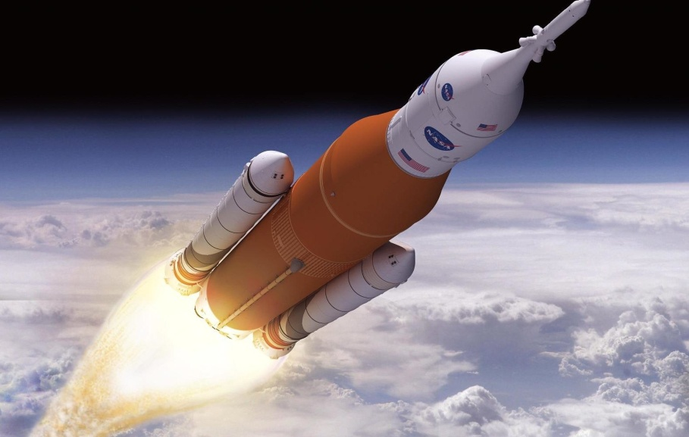
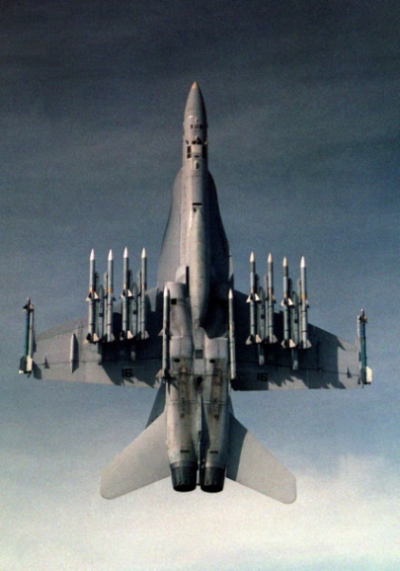
Capabilities Overview
UNCLASSIFIED
UNCLASSIFIED

Slide 2
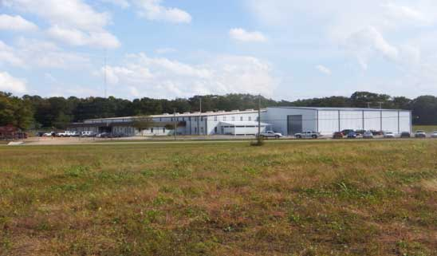
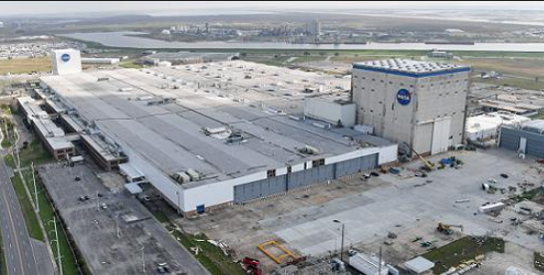
Facilities
UNCLASSIFIED
Arab, Alabama
BK Aerospace was founded by Mr. Bob Kelley in 1967, and is a Woman-Owned Small Business headquartered, in Arab, AL.
Arab is located just south of Huntsville, AL and is in close proximity to Redstone Arsenal and NASA Marshall Space Flight Center.
75,000 square feet of state of the art, climate controlled, secured facilities
New Orleans, Louisiana
BK is also currently a tenant at the NASA Michoud Assembly Facility (MAF) in New Orleans, LA.
BK was on-site for 1 year at Stennis Space Center, MS. with a Mobile Machine Shop.

Slide 3
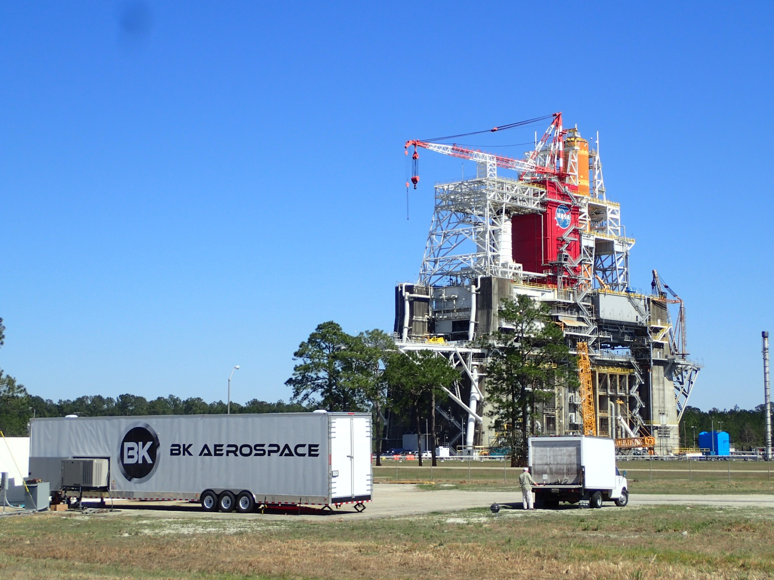
BK Mobile Machine Shop
UNCLASSIFIED
NASA Stennis Space Center
Tooling & Interface Modifications
Mills & Lathes
MIG & TIG Welding
Climate Controlled
Generator Backup
24/7 Operation

Slide 4
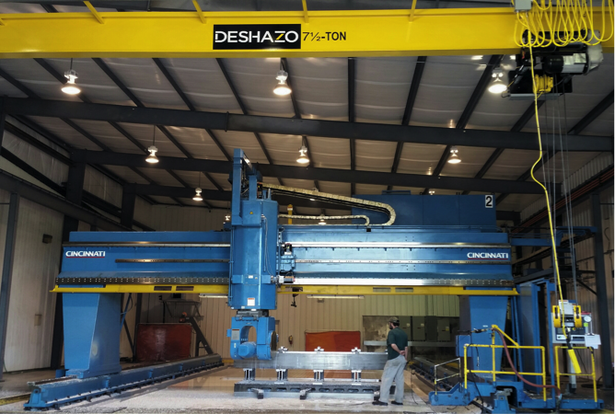
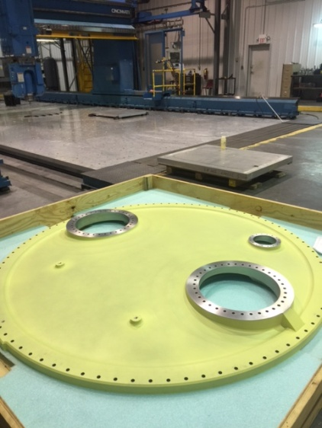
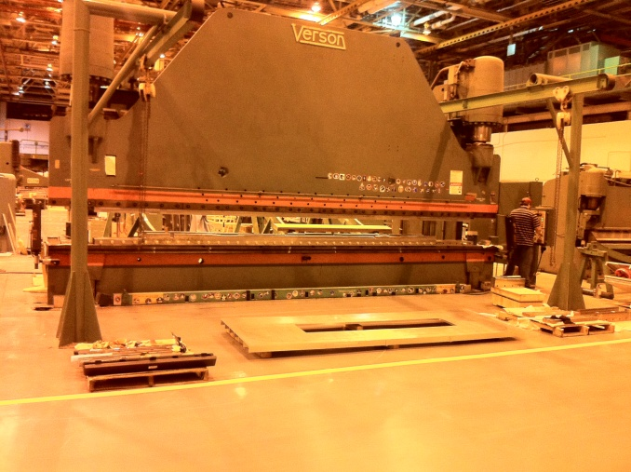
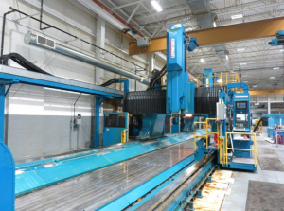
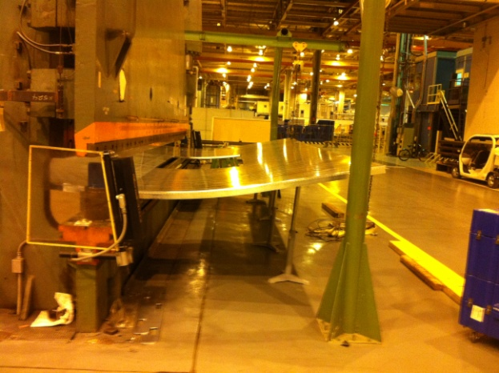
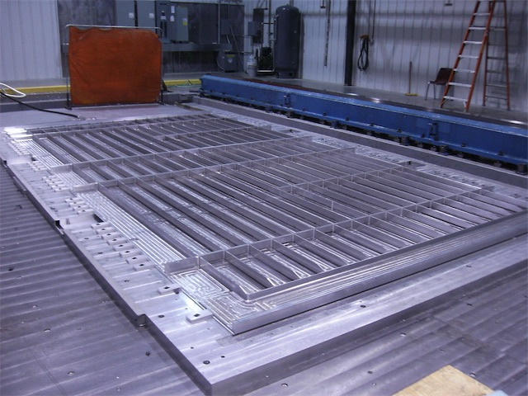
Large Scale Machining & Integration
UNCLASSIFIED
One thing that truly makes BK stand out from its competition is the capability to machine and integrate LARGE SCALE ITEMS.
Large Scale SLS Panel Fabrication and Bump Forming (Arab -- Michoud)
Rough Dimensions:
X Axis (60 feet)
Y Axis (28 feet)
Z Axis (4.5 feet)
NOW Operational: 2 x 100’x 11’x 5’
20’ x 51’ Work plate

Slide 5
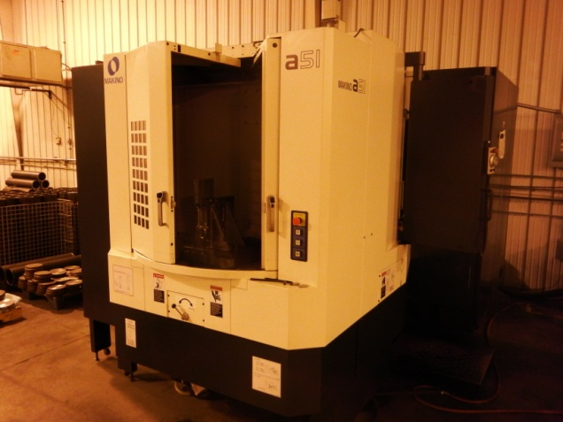
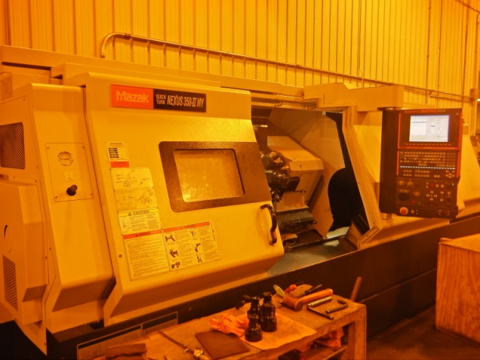
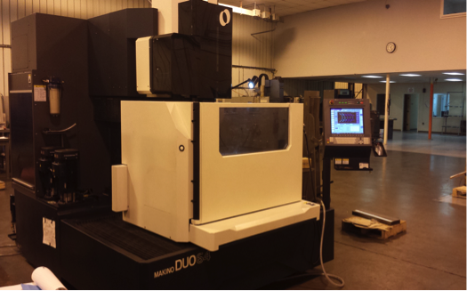
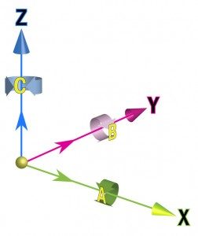
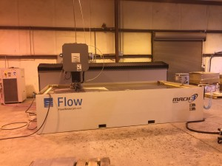
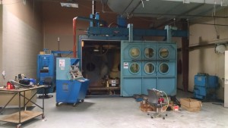
UNCLASSIFIED
CNC shop equipment – various sizes
CNC Milling – 3,4,& 5 axis
CNC Lathe (turning) – 3,4, & 5 axis
Wire EDM
Water jet machining
Electron Beam Welder
Sciaky Model VX.3
Largest in SE USA
Can be configured
as a 3-D Printer

Slide 6
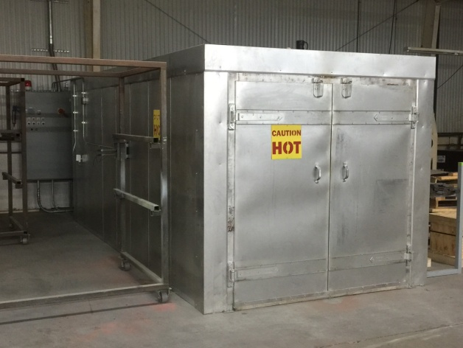
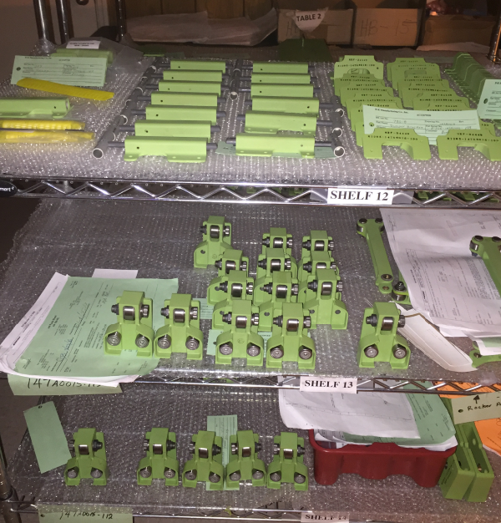
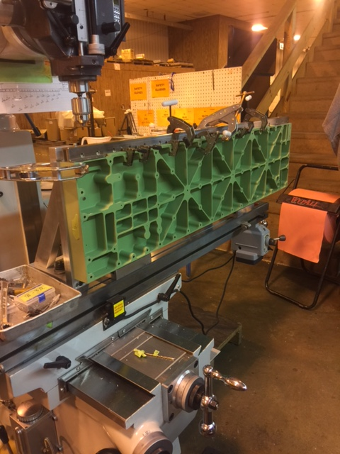
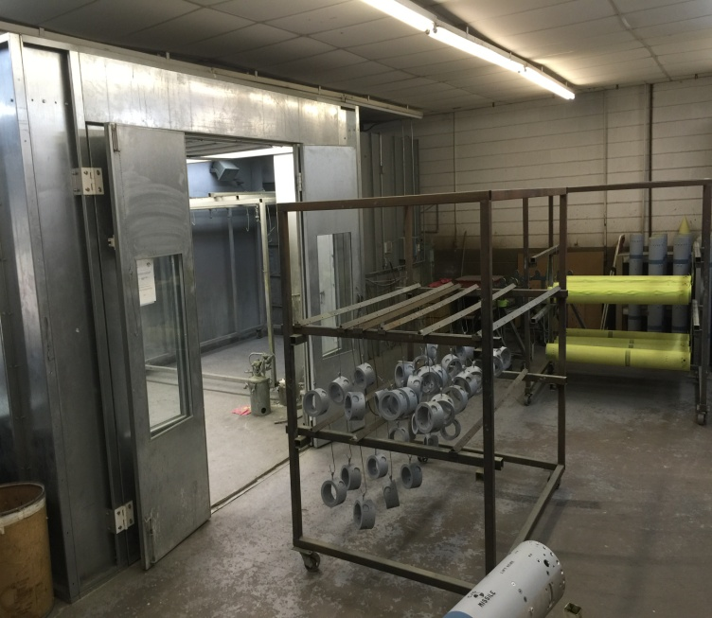
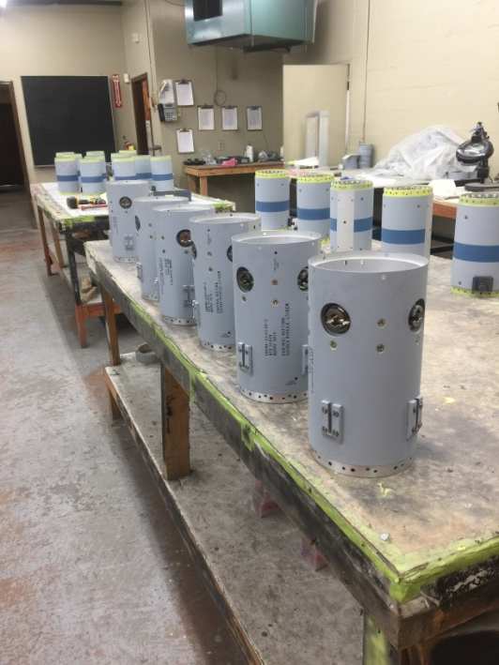
Assembly, Paint, & Special Processes
UNCLASSIFIED
BK has assembly facilities in-house, as well as a 12,500 square foot paint/special process facility.
Our in house paint facility has a large humidity controlled
paint booth, curing ovens, assembly and storage space.
Special process capability includes shot peen and bead blast.
BK certified welding capability includes TIG and MIG.

Slide 7




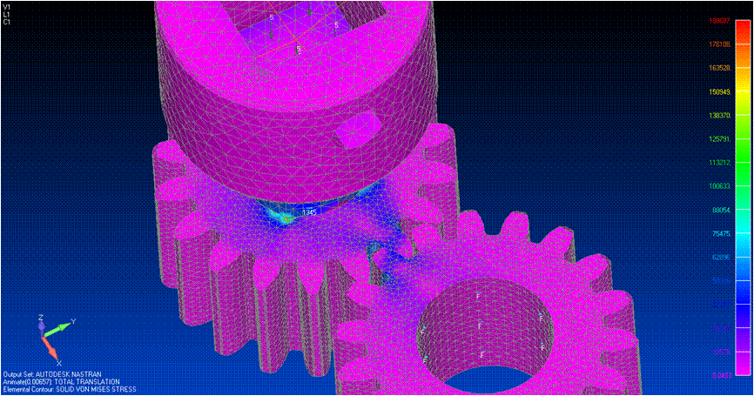
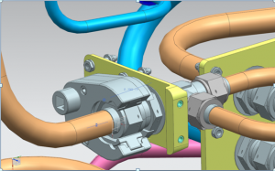
UNCLASSIFIED
Engineering, Testing, and Design
BK has a complete engineering staff consisting of:
- Mechanical - 2
- Electrical - 1
- Aerospace - 1
Industrial and Systems - 1
Manufacturing - 1
Relevant Software:
- CATIA
- FEMAP
- NX/NASTRAN
President is a Physicist with Masters Degree
BK performs a wide variety of engineering services in- house that includes:
- Research & development (R&D)
- Testing and test design
3D Printing
3D modeling
Design/Analysis
Stress analysis/FEA
Reverse Engineering

Slide 8
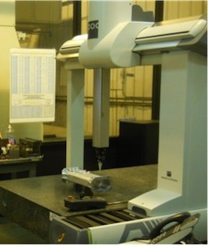
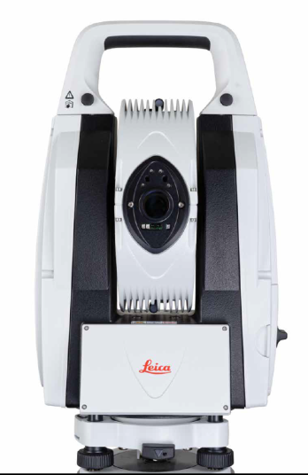
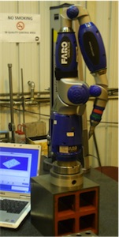
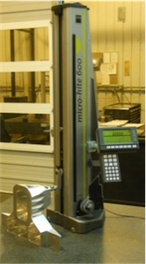
Quality Control
UNCLASSIFIED
Meeting and/or exceeding customer demand is our top priority at BK.
BK’s quality system is 3rd party registered and certified to ISO 9001:2015 and AS9100D:2016 for Design, Manufacturing, Integration and Testing.
BK has invested in high-precision, state of the art scanning and measurement equipment.
Inspection is carried out in temperature and FOD controlled areas.
Model Based Definition (MBD) Approved with Boeing and Lockheed Martin.
IT Security: NIST 800-171r1 Implemented.
    CMMC is in progress.

Slide 9
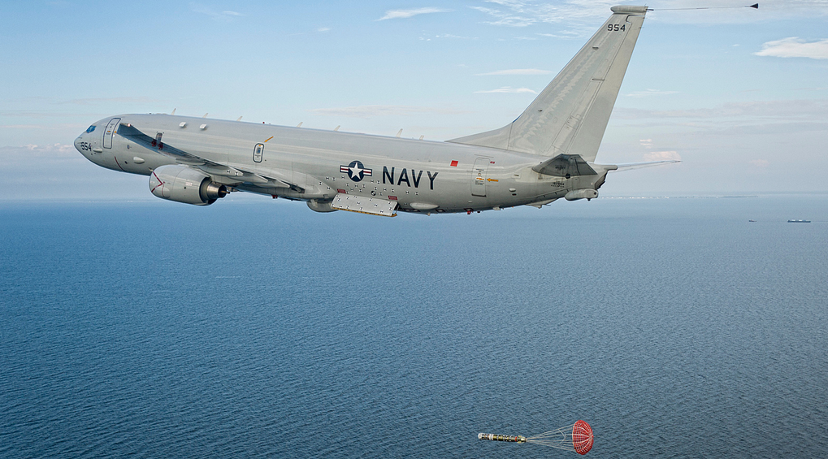
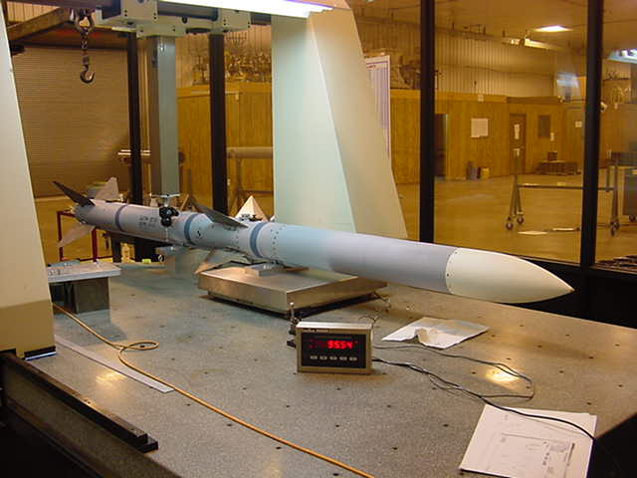
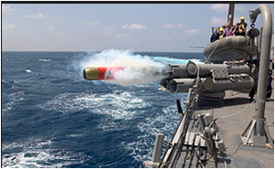
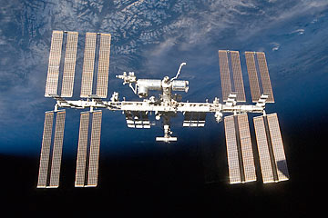
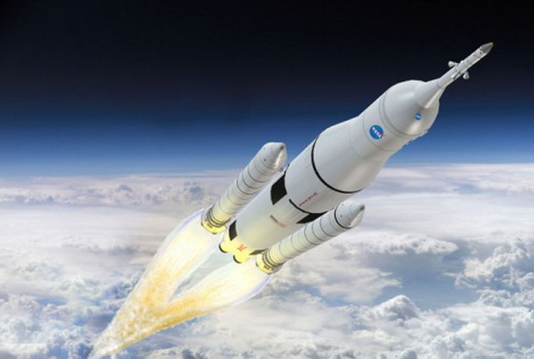
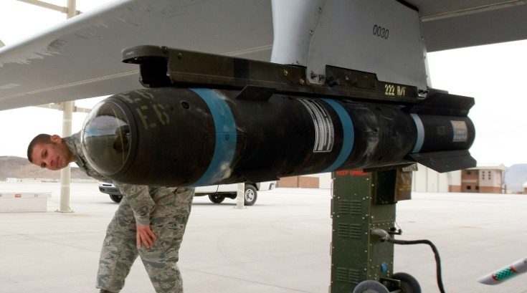
Some of Our Quality Products
UNCLASSIFIED
P8 Poseidon Bailout Door Assembly
AMRAAM CATM-120
MK-54 REXTORP
Tooling for the International
Space Station
NASA SLS Tooling and Hardware
M34 Hellfire Trainer

